Slide 1

Green University of Bangladesh
Department of Computer Science and Engineering (CSE)
Faculty of Sciences and Engineering
Semester: Spring, Year: 2022, B.Sc. in CSE (DAY)
LAB REPORT NO # 04
Course Title: Structured Programming Lab
Course Code: CSE 104 Section: CSE 213 - DB (PC)
Lab Experiment Name(s):
While and Do - While Loop and Control Structure in C
Student Details
Name | ID
Md. Shahidul Islam Prodhan | 213902017
Lab Date: 26 February 2022
Submission Date: 05 March 2022
Course Teacher’s Name: Md. Solaiman Mia, Assistant Professor.
[For Teacher’s use only: Don’t write anything inside this box]
Lab Report Status
Marks: | Signature:
Comments: | Date:

Slide 2
1. TITLE OF THE LAB EXPERIMENT
Lab Report of While and Do -While Loop Control Structure in C
2. OBJECTIVES
By doing this experiment we will learn about different kinds of loops in the C language and we will be able to solve complex problem using loops.
3. PROCEDURE
Problem 1: Write a C program to find sum of first and last digit of any number.
First we declare the necessary variables in int function and take input from the user a valid integer by using printf and scanf function. Then we keep first digit in n variable and for last digit we use mod of 10 (n % 10). By using while loop we decide the first digit will be equal or greater than 10. Then we sum the first and last digit and print the result.
Problem 2: Write a C program to swap first and last digits of any number.
First we declare necessary variables and take valid input from the user. Then for the last digit we use mod operator. When modulo divided by 10 returns last digit of the input number. Find the first digit with the help of mathematical operation. We use necessary logic to swap first and the last digit.
Problem 3: Write a C program to calculate product of digits of any number.
At first, we declare necessary variables and take valid user input. We use while loop until num is not equals to 0. We store product in product variable and multiply that with num variable. Then we print the output.
Problem 4: Write a C to find the sum of the series 1 +11 + 111 + 1111 + .. n terms.
We take necessary variables to and functions. We use int, long and long int to store large type of number. We take valid user input and run it in for loop. Then by using if condition we check if the i < n. we use sum variable to store sum and to increase 1. Then we print the sum of the nth terms of that following series.
Problem 5: Write a C program to find frequency of each digit in a given integer.
We take necessary variables and take array because the number of numbers is 10. We take valid user input and use for loop where we use array. In while loop we check if n is not equaling to 0. We use while loop and if conditions to perform the following problem.

Slide 3
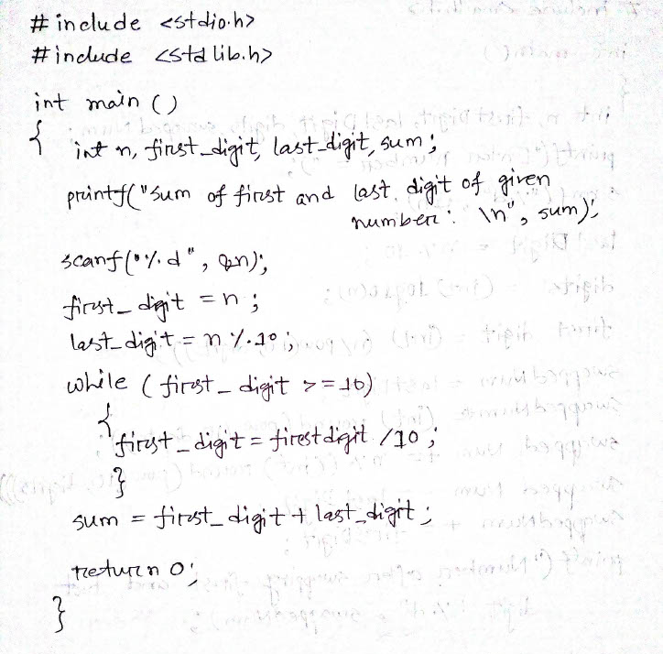
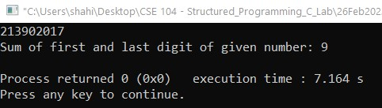
4. IMPLEMENTATION & TEST RESULT
Problem 1: C program to find sum of first and last digit of any number.

Slide 4
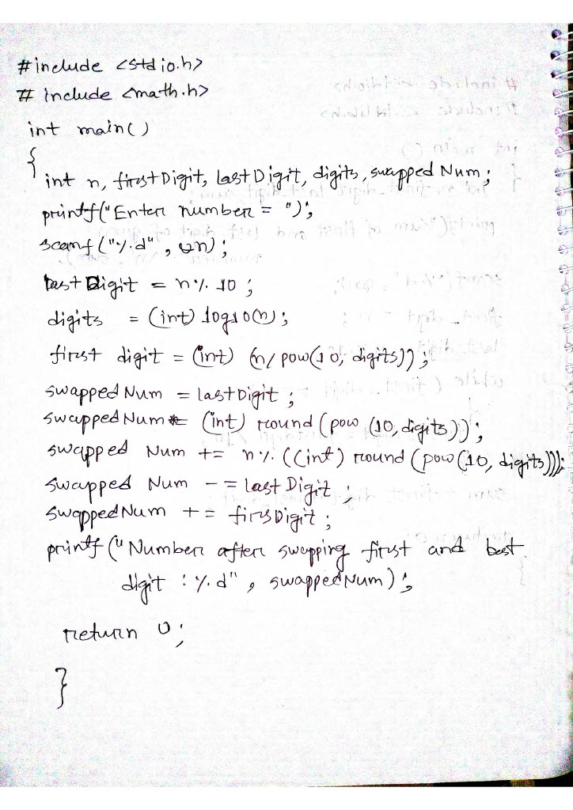
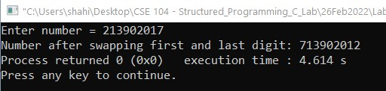
Problem 2: C program to swap first and last digits of any number.

Slide 5
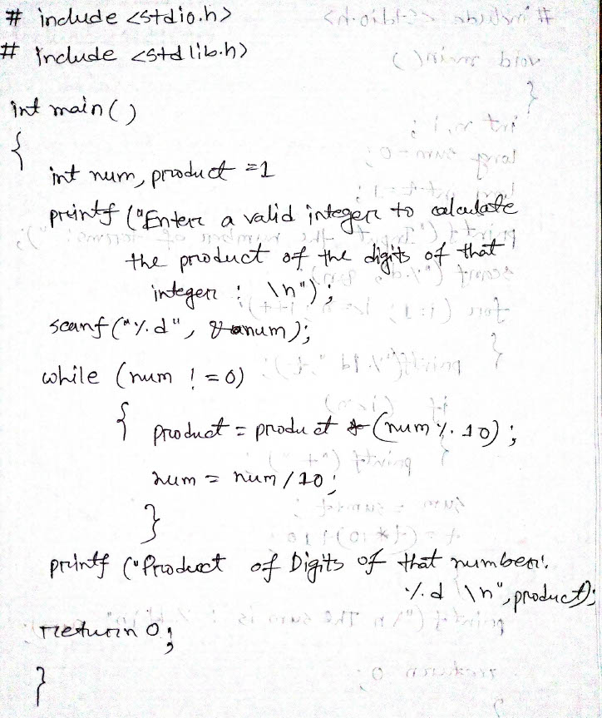
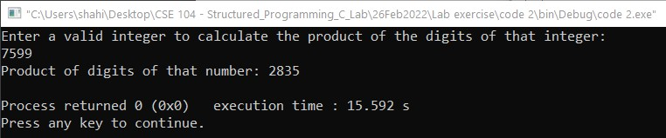
Problem 3: C program to calculate product of digits of any number.

Slide 6
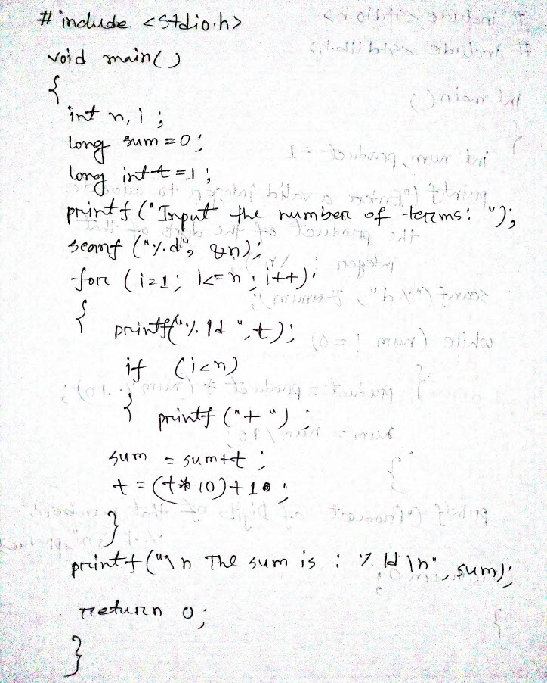
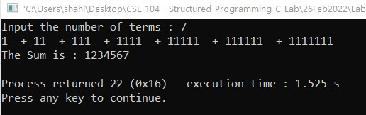
Problem 4: C to find the sum of the series 1 +11 + 111 + 1111 + .. n terms.

Slide 7
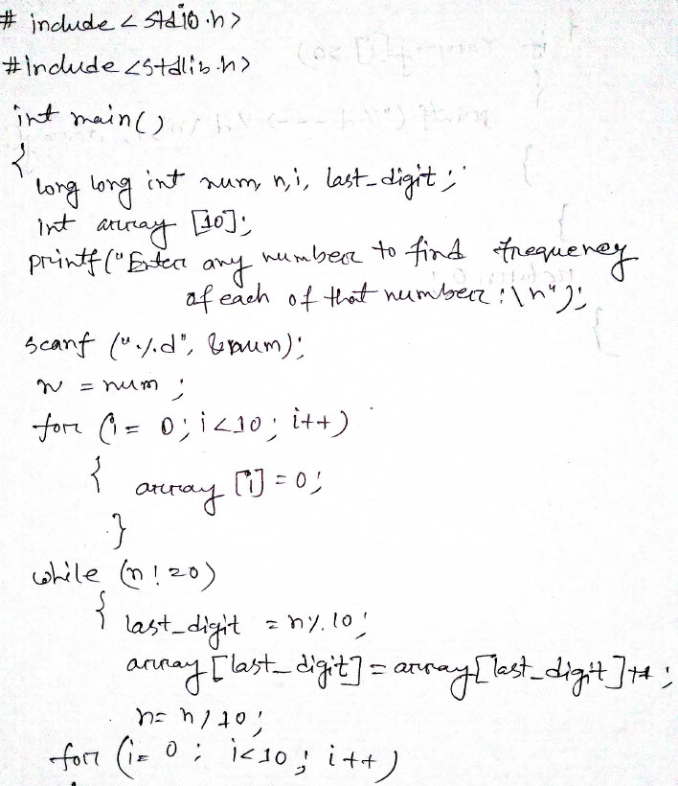
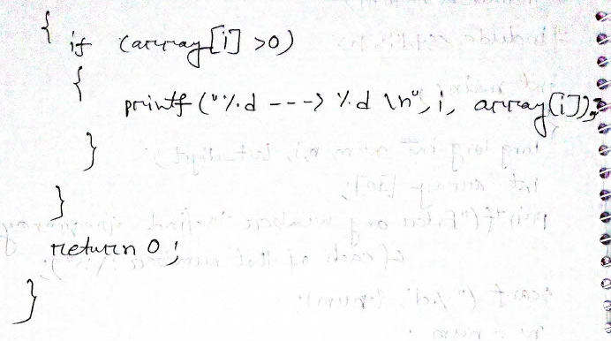
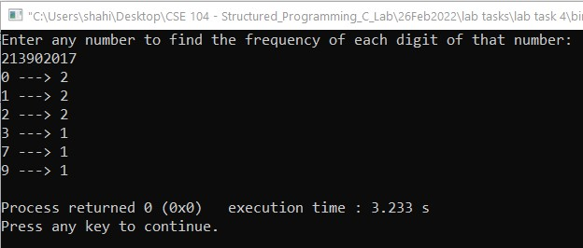
Problem 5: C program to find frequency of each digit in a given integer. (Lab Task)

Slide 8
6. ANALYSIS AND DISCUSSION
We have solved those problems using CodeBlocks IDE and there were no errors occurred. And we can successfully print the output of those problems.
We have faced a little bit difficulty while performing 2nd and 5th problem showing the wrong results but then we have passed errors and corrected our program and it gives correct result.
Solving these 5 problems, we have initially learned the very basics of how to solve complex problems in C language using different loops.
7. SUMMARY
From the given experiments, we have learned the very basic implementation of C language in order to make some complex level calculations and decisions which introduces us with the following function/statements/loops – While and Do - While Loop.

